Slide 1
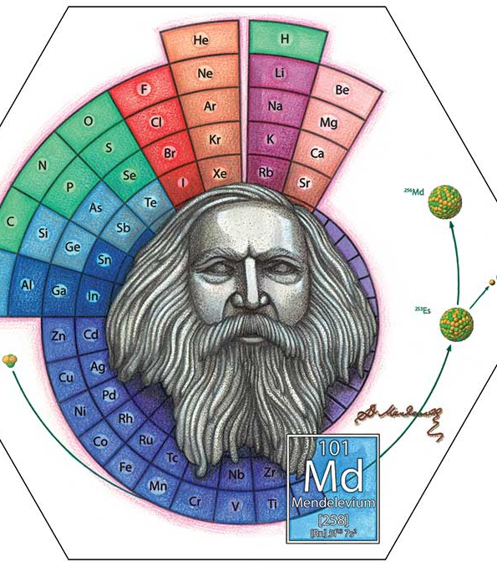
Electronic structure and the Periodic Table

Slide 2

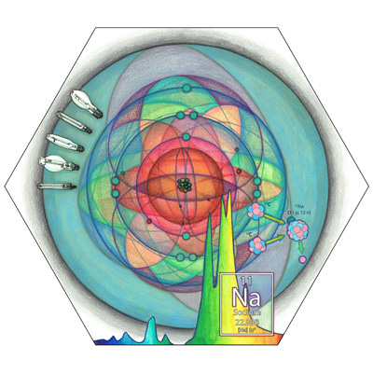
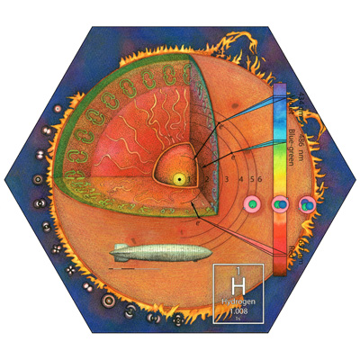
Overview
Electron configuration
Periodic table and electron configuration
Quantization of energy
Artwork from http://www.periodictable.ga/

Slide 3
Bohr model of the atom
Bohr proposed a model of a hydrogen atom that explained the characteristic production of light
The model proposed
Electrons orbit the nucleus in fixed, circular orbits
Electrons’ orbits correspond to fixed energy levels or shells
Electron can only occupy fixed energy levels, they cannot be in between energy levels
The larger the radii (further from the nucleus) is higher energy

Slide 4
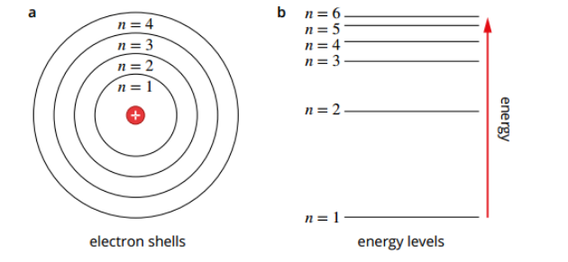
Bohr model of the atom

Slide 5
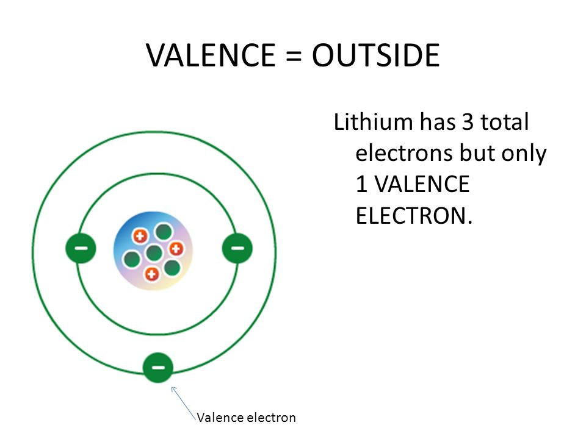
Bohr model of the atom
Outermost shell = valence shell
Electrons in the outermost shell are called valence electrons
Valence electrons are involved in chemical reactions
Atoms with a full valence shell are very stable. This is called the octet rule. The noble gases have full valence shells.

Slide 6
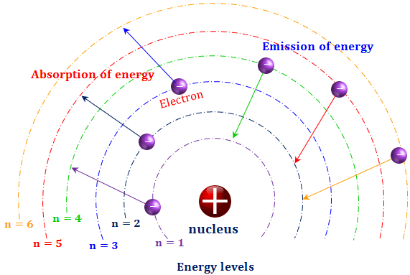
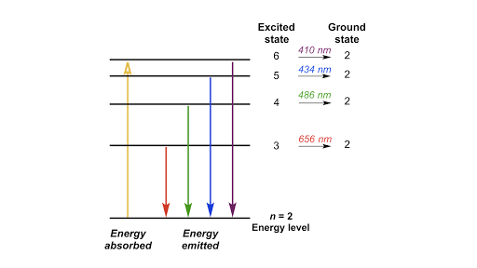
Bohr model of the atom
Bohr suggested it was possible for electrons to move between energy levels by absorbing or emitting energy

Slide 7
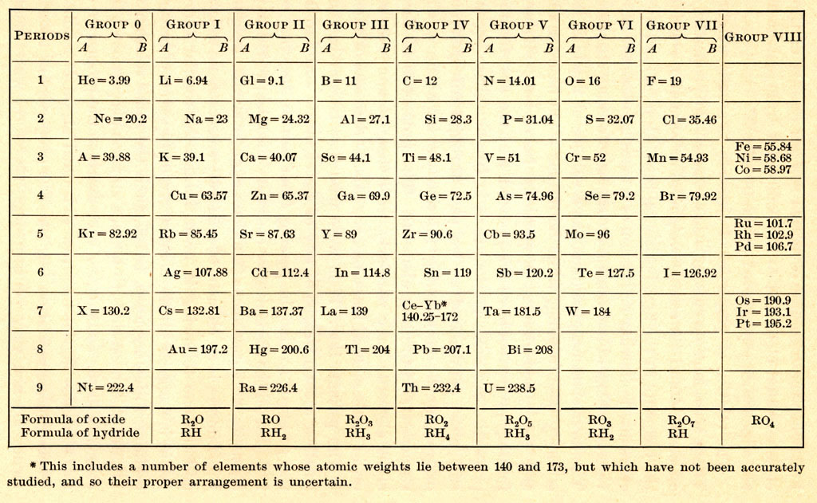
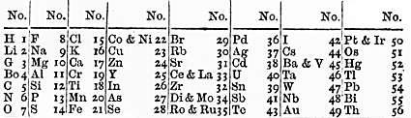
The Periodic Table
The periodic table is an arrangement of elements, organized in a way to highlight the periodic nature of their repeating properties
A few different designs were suggested but the modern Periodic Table is now universally used
Newlands’ Law of octaves
Mendeleev’s Periodic Table
Artwork from http://www.periodictable.ga/

Slide 8
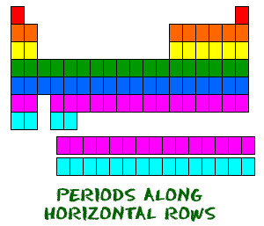
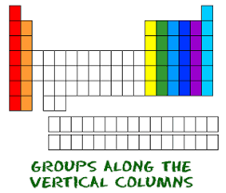
The Periodic Table
Elements are arranged in rows of increasing atomic numbers (left to right), and in columns according to the number of valence electrons and therefore chemical properties.

Slide 9
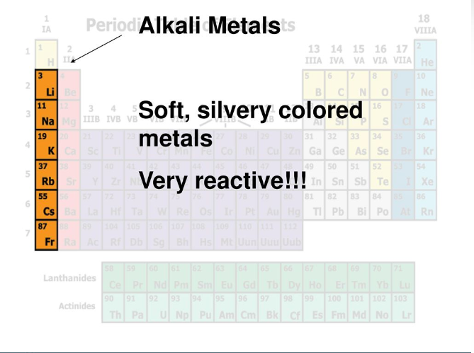
The Periodic Table

Slide 10
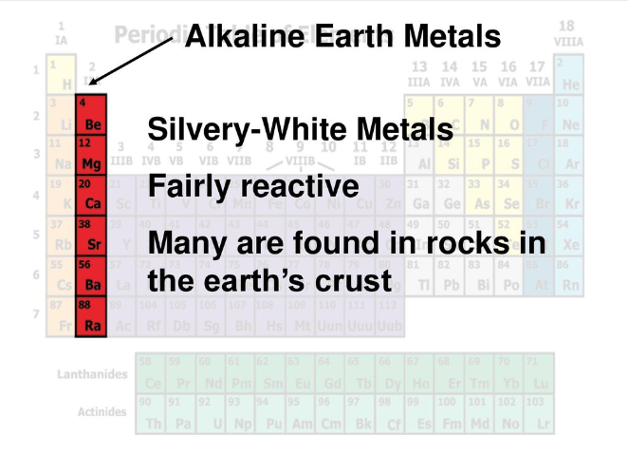
The Periodic Table

Slide 11
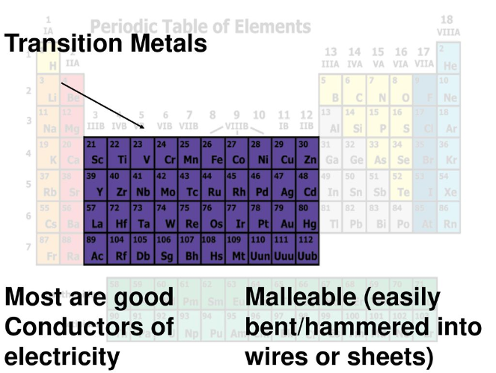
The Periodic Table

Slide 12
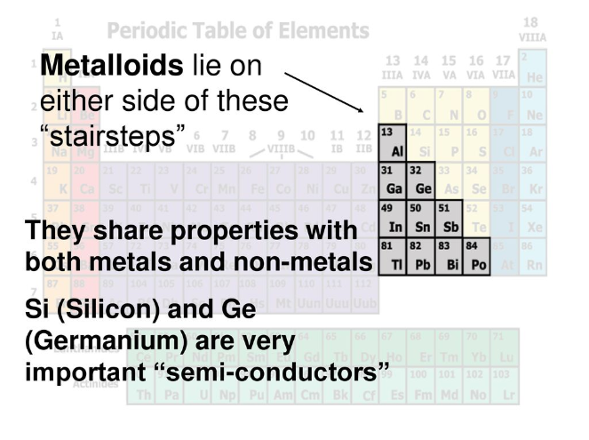
The Periodic Table

Slide 13
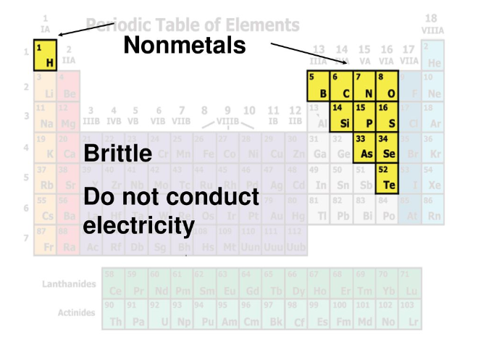
The Periodic Table

Slide 14
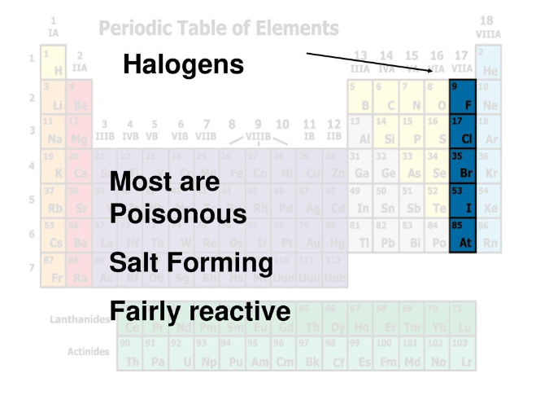
The Periodic Table

Slide 15
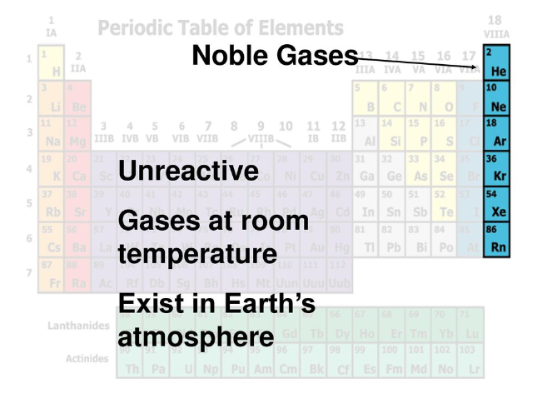
The Periodic Table

Slide 16
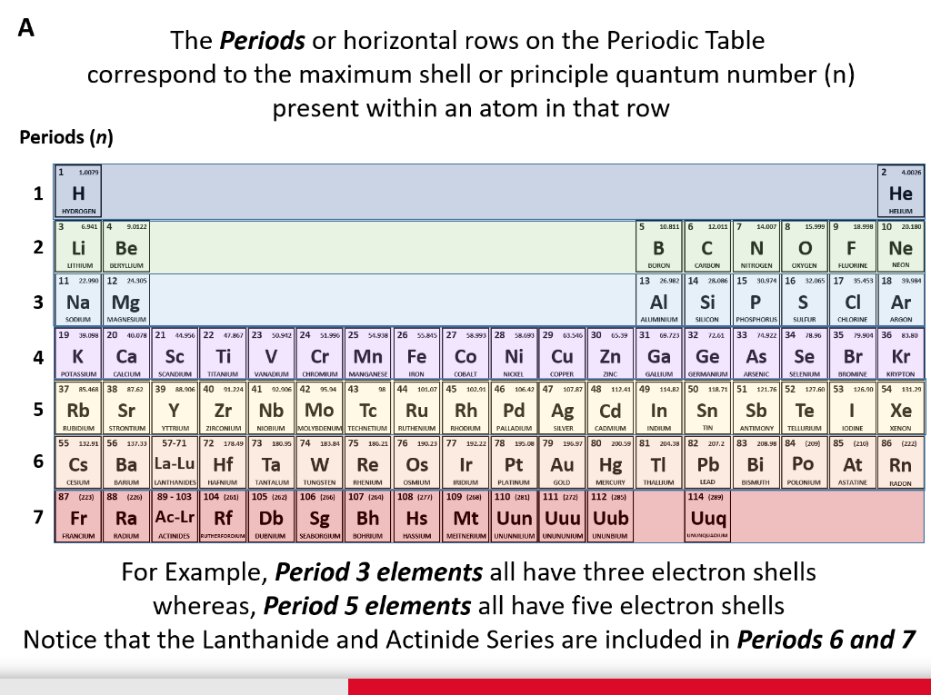
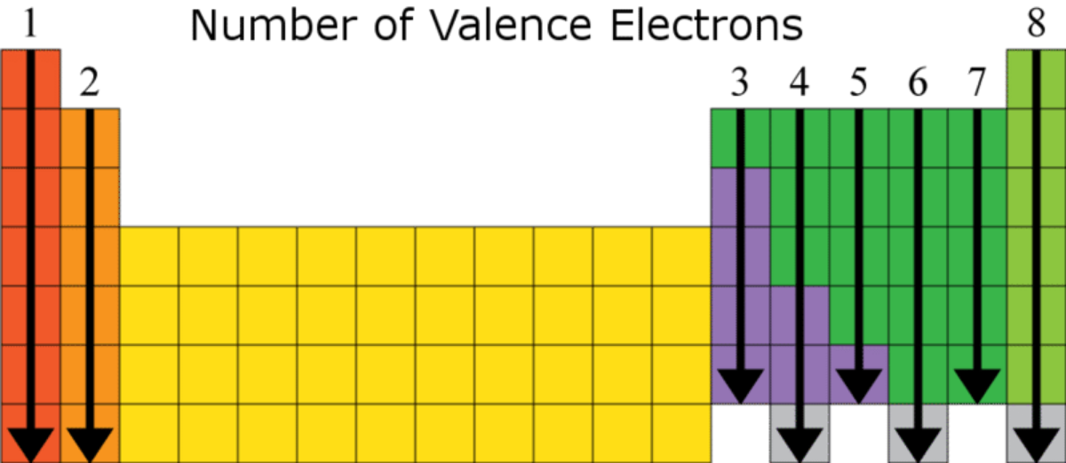

Slide 17
Electron configuration
The chemical and physical properties of elements repeat periodically with certain increments in atomic number (2, 8, 8, 18, 18, 32 and so on)
This can be explained by applying Bohr’s model of the atom – electrons exist in shells.
Shells increase in energy and distance from the nucleus
Remember the rule for the number of electrons a shell can hold?
Max number electrons in a shell (n) = 2n²

Slide 18
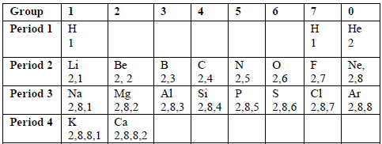
Electron configuration
You need to be able to write and draw the electron configuration for the first 20 elements of the Periodic Table

Slide 19
Electron configuration
Fast way to write an electron configuration – use your Periodic Table!
The group gives you the number of valance electron
The period gives you the outermost shell
E.g. Nitrogen grp 5 and period 2
has 2 shells, 5 outer electrons
5 valence electrons
2,5
2 shells

Slide 20

Valence electrons
Valence electrons – electrons in the outermost shell of an atom
Core electrons – electrons found in the inner shells of the atom. They are not shown in the Lewis structure
Only valence electrons are involved in chemical bonding

Slide 21
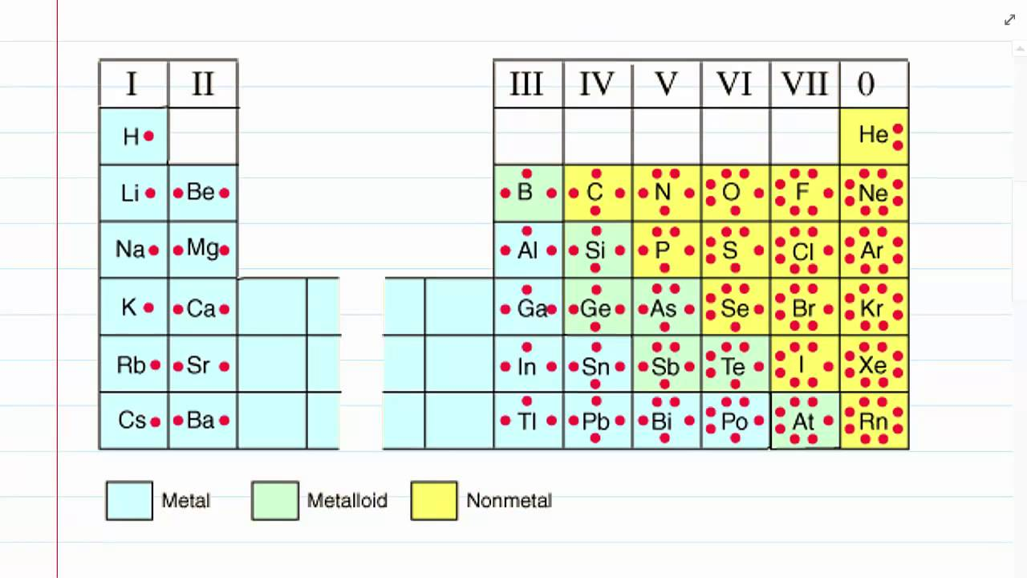
Valence electrons

Slide 22
Ions
Atoms lose or gain electrons, they are no longer neutral
Anions – negatively charged ions (have gained extra electrons)
Cations – positively charged ions (have lost electrons)
Electron configuration:
Cl 2,8,7 for it to reach the octet rule it must gain one electron
Cl⁻ 2,8,8
Na 2, 8, 1 to reach octet it must lose an electron
Na⁺ 2,8

Slide 23
Quantisation of energy
Bohr’s model identified that electrons exist at discrete energy levels, the energy levels are described as being quantised
The model allows electrons to move between the discrete levels by absorbing or emitting energy
Ground state – the lowest energy state for an atom
Excited state – when the atom has absorbed energy and an electron has moved to a higher energy level
The excited state is inherently unstable and only exists for a short time, before relaxing back to the ground state.

Slide 24
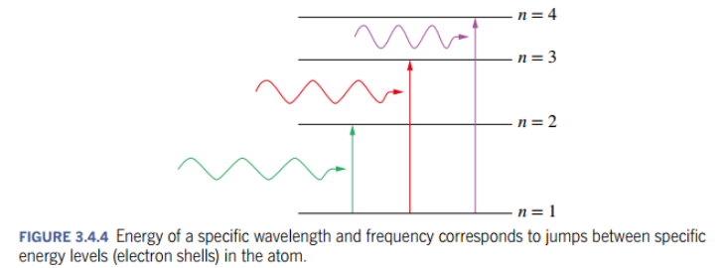
Quantisation of energy

Slide 25
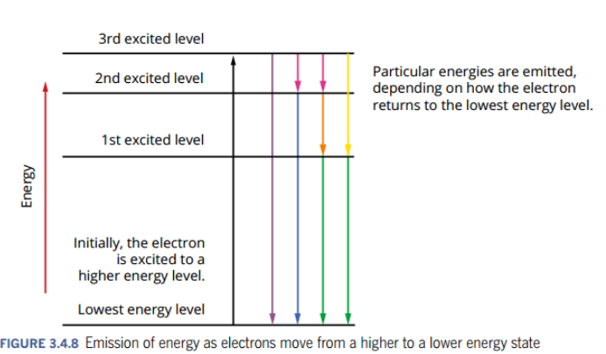
Quantisation of energy

Slide 26
Quantisation of energy
Electron configuration review – we can write an electron configuration for a neutral atom and an ion, we can also write an electron config for an excited atom
Example: Oxygen
Ground state: 2, 6
Excited state: 2,5,1
We now have one electron in a higher energy level

Slide 27
On going work
Pearson read: 3.1, 3.2 and 3.4
Complete review sets 3.1, 3.2 and 3.4
Should be able to complete Chapter 1 Review, Chapter 2 Review and most of the Chapter 3 Review (trends in the periodic table will NOT be in the period zero)

